Slide 1
CSCI 566: Deep Learning and Its Applications
Jesse Thomason
Lecture 7: Transformers and DL for Vision

Slide 2
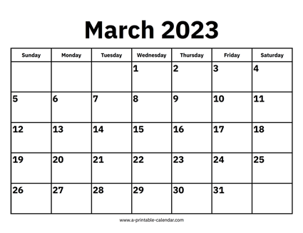
[Mar 10] March Deliverables
Project Pitch | Mar 3
Assignment 2 OUT | Mar 10
Project Survey Report | Mar 10
NO CLASS | Mar 17
Assignment 2 Due | Mar 31
Project Midterm Report | Mar 31

Slide 3
Survey Reports Due Today, 11:59pm
A literature survey (e.g., "Related Work" section in a conference paper)
(1) What has been done related to your proposal?
This may comprise multiple paragraphs/sections of different related areas and efforts
(2) What are the limitations or challenges remaining to be solved?
What are the open questions? At least one of these should be what your project aims to address, though you should highlight others too.
Format: a 1.5-2 page (double-column) literature review write-up.
Additionally, a single page summary of contributions from each team member on your project.
Spell out your individual contributions clearly on that final page.

Slide 4
Overview of Today’s Plan
Course organization and deliverables
Any questions before we move on?
Transformers
DL for Computer Vision
Midterm Debrief

Slide 5

NLP FUNDAMENTALS: Language Models
A language model is an estimate of the likelihood of a string
Tokenizing the string into component parts is necessary
So we can consider a string s as a sequence of tokens w₁…w_{n}
Then a language model estimates:
p(s) = p(w₁…w_{n})
Term is overloaded; also used these days to mean:
p(w_{k}|w₁…w_{k-1}) — (e.g., auto-regressive)
p(w_{k}|w₁…w_{k-1}w_{k+1}…w_{n}) — (e.g., cloze / MLM)

Slide 6
f: X ✕ Θ → Y;
f(x;θ)=y; θ∈Θ for model M
f: X → Y;
f(x)=y
f: ɸ_{x}(X) ✕ Θ → ɸ_{y}(Y);
f(x;θ)=y
f: ɸ_{x}(X) → ɸ_{y}(Y);
f(x)=y
DL enables function approximation for f and is constrained by:
Data representation ɸ
Model architecture M
Loss function L
Optimization algorithm
Training data D
θ*=min_{θ∈Θ}(Σ_{(x,y)}L(f(x;θ), y)))
θ*=min_{θ∈Θ}(Σ_{(x,y)∈D}L(f(x;θ), y)))

Slide 7
NLP FUNDAMENTALS: Word Embeddings
A word embedding is a vector representation of a word
Word embeddings can be learned for specific tasks (e.g., our book classification task) or from self-supervised objectives
“You shall know a word by the company it keeps” - Firth
The guiding principle of many learned word embeddings is that two words who share similar context should have embeddings that are close together in vector space
J.R. Firth. A synopsis of linguistic theory. Studies in linguistic analysis, Blackwell, Oxford (1957)

Slide 8
N-gram language models
How could we efficiently estimate p(w_{n}|w₁…w_{n-1})?
Independence assumptions!
Does a word k away in the history really affect what word comes next that much? What if we assume:
p(w_{n}|w₁…w_{n-1}) ≈ p(w_{n}|w_{n-k+1}…w_{n-1})
Then if we say “a word 4 away in the history does not affect me”, then p(w_{n}|w₁…w_{n-1}) ≈ p(w_{n}|w_{n-3}w_{n-2}w_{n-1})
How big on disk?
|V|*|V|*|V|*|V| = |V|⁴

Slide 9
Bag-of-Words Model
Estimate p(w_{i}|w_{i-1}w_{i-2}…w_{i-n+1}) as distribution of w_{i} given that w_{i-1}w_{i-2}…w_{i-n+1} occur in any order left of w_{i}
Pros:
Space to store this model is |V|²
Model will be considerably less sparse
Cons:
Loss of order information will hurt POS guessing / syntax generally
Still too sparse! Need to learn a compressed representation

Slide 10
Word2Vec: Recap
253
999
320
780
998
happy
<S>
i’m
today
<E>
Fully Connected Layer
Fully Connected Layer
Sum
Embedding V_{e}(t)
253
happy
Embedding Layer V_{e}(t)
Skip-Gram; p(w_{i-2}|w_{i})p(w_{i-1}|w_{i})p(w_{i+1}|w_{i})p(w_{i+2}|w_{i})
999
320
780
998
<S>
i’m
today
<E>
CBOW; p(w_{i}|{w_{i-2}w_{i-1}w_{i+1}w_{i+2}})

Slide 11
Tokenization and Batching
Sequence Start/End Tokens
997
1
320
253
281
6
0
287
4
998
START
a
tropical
bird
perches
in
the
jungle
.
END
997
1
490
322
163
4
998
999
999
999
START
a
small
white
fox
.
END
PAD
PAD
PAD
Mini-Batch
997
0
330
261
8
1
1000
741
18
475
START
the
orange
spider
on
a
UNK
leaf
is
sitting
997
82
189
4
998
999
999
999
999
999
START
big
elephant
.
END
PAD
PAD
PAD
PAD
PAD
Padding Tokens
…

Slide 12
Machine Translation and The Case for Contextual Info
893
489
998
شجرتان
shajaratan
تتمايلان
tatamayalan
<E>
s(h_{d})
s(h_{d})
s(h_{d})
Decoder D hidden state h_{d}
RNN
RNN
RNN
RNN
RNN
RNN
RNN
RNN
Embedding Layer V_{d}(t)
999
893
489
<S>
شجرتان
shajaratan
تتمايلان
tatamayalan
Embedding Layer V_{e}(t)
999
128
137
783
998
<S>
two
trees
sway
<E>

Slide 13
Machine Translation and The Case for Contextual Info
893
شجرتان
shajaratan
s(h_{d})
Decoder D hidden state h_{d}
RNN
RNN
RNN
RNN
RNN
RNN
Embedding Layer V_{d}(t)
999
<S>
Embedding Layer V_{e}(t)
999
128
137
783
998
<S>
two
trees
sway
<E>

Slide 14
Use Attention to Rewrite RNN State Input
∈R
893
a=FC(h_{d1},h_{ei})
شجرتان
shajaratan
Σ_{i=1…L}h_{ei}exp(a(h_{d1},h_{ei}))
s(h_{d})
Init decoder D hidden state h_{d1}=h_{eN}
[Σ_{j=1…L}exp(a(h_{d1},h_{ej}))]
RNN
RNN
RNN
RNN
RNN
RNN
RNN
Embedding Layer V_{d}(t)
999
<S>
Embedding Layer V_{e}(t)
999
128
137
783
998
<S>
two
trees
sway
<E>

Slide 15
Attention
893
شجرتان
shajaratan
Σ_{i=1…L}h_{ei}exp(a(h_{d1},h_{ei}))
s(h_{d})
[Σ_{j=1…L}exp(a(h_{d1},h_{ej}))]
RNN
RNN
RNN
RNN
RNN
RNN
Embedding Layer V_{e}(t)
999
128
137
783
998
a=FC(h_{d1},h_{e1})
a=FC(h_{d1},h_{e2})
a=FC(h_{d1},h_{e3})
a=FC(h_{d1},h_{e4})
a=FC(h_{d1},h_{e5})
<S>
two
trees
sway
<E>

Slide 16
Attention
893
شجرتان
shajaratan
Σ_{i=1…L}h_{ei}exp(a(h_{d1},h_{ei}))
s(h_{d})
[Σ_{j=1…L}exp(a(h_{d1},h_{ej}))]
RNN
RNN
RNN
RNN
RNN
RNN
e
e
e
e
e
Σ
e
Σ
e
Σ
e
Σ
e
Σ
e
Embedding Layer V_{e}(t)
999
128
137
783
998
a=FC(h_{d1},h_{e1})
a=FC(h_{d1},h_{e2})
a=FC(h_{d1},h_{e3})
a=FC(h_{d1},h_{e4})
a=FC(h_{d1},h_{e5})
<S>
two
trees
sway
<E>

Slide 17
Multi-Headed Attention
893
h_{d2}=
شجرتان
shajaratan
Σ_{i=1…L}h_{ei}exp(a(h_{d1},h_{ei}))
s(h_{d})
[Σ_{j=1…L}exp(a(h_{d1},h_{ej}))]
RNN
RNN
RNN
RNN
RNN
RNN
e
e
e
e
e
Σ
e
Σ
e
Σ
e
Σ
e
Σ
e
Embedding Layer V_{e}(t)
999
128
137
783
998
a=FC(h_{d1},h_{e1})
a=FC(h_{d1},h_{e2})
a=FC(h_{d1},h_{e3})
a=FC(h_{d1},h_{e4})
a=FC(h_{d1},h_{e5})
<S>
two
trees
sway
<E>

Slide 18
Multi-Headed Attention
h_{d2}
893
h¹_{d2}=
Add+Norm
شجرتان
shajaratan
h²_{d2}=
Σ_{i=1…L}h_{ei}exp(a(h_{d1},h_{ei}))
s(h_{d})
[Σ_{j=1…L}exp(a(h_{d1},h_{ej}))]
RNN
RNN
RNN
RNN
RNN
RNN
e
e
e
e
e
e
e
e
e
e
Σ
e
Σ
e
Σ
e
Σ
e
Σ
e
Σ
e
Σ
e
Σ
e
Σ
e
Σ
e
Embedding Layer V_{e}(t)
999
128
137
783
998
998
a₂=FC(h_{d1},h_{e1})
a=FC(h_{d1},h_{e1})
a₂=FC(h_{d1},h_{e2})
a=FC(h_{d1},h_{e2})
a₂=FC(h_{d1},h_{e3})
a=FC(h_{d1},h_{e3})
a₂=FC(h_{d1},h_{e4})
a=FC(h_{d1},h_{e4})
a₂=FC(h_{d1},h_{e5})
a=FC(h_{d1},h_{e5})
<S>
two
trees
sway
<E>
<E>

Slide 19
Multi-Headed Attention
h_{d2}
h¹_{d2}=
Add+Norm
893
h²_{d2}=
شجرتان
shajaratan
h³_{d2}=
Σ_{i=1…L}h_{ei}exp(a(h_{d1},h_{ei}))
s(h_{d})
[Σ_{j=1…L}exp(a(h_{d1},h_{ej}))]
RNN
RNN
RNN
RNN
RNN
RNN
e
e
e
e
e
e
e
e
e
e
e
e
e
e
e
e
e
e
e
e
e
e
e
e
e
e
e
Σ
Σ
Σ
e
e
e
Σ
Σ
Σ
Σ
Σ
Σ
Σ
Σ
Σ
Σ
Σ
Σ
Embedding Layer V_{e}(t)
999
128
137
998
783
998
998
a₃=FC(h_{d1},h_{e1})
a₂=FC(h_{d1},h_{e1})
a₃=FC(h_{d1},h_{e2})
a=FC(h_{d1},h_{e1})
a₂=FC(h_{d1},h_{e1})
a₃=FC(h_{d1},h_{e3})
a=FC(h_{d1},h_{e2})
a₂=FC(h_{d1},h_{e1})
a₃=FC(h_{d1},h_{e4})
a=FC(h_{d1},h_{e3})
a₂=FC(h_{d1},h_{e1})
a₃=FC(h_{d1},h_{e5})
a=FC(h_{d1},h_{e4})
a₂=FC(h_{d1},h_{e1})
a=FC(h_{d1},h_{e5})
<S>
two
trees
<E>
sway
<E>
<E>

Slide 20
Contextual Word Embeddings
Consider the word vectors in the following sentences:
x = {“she launched into a bass solo”, “the line went taut as the bass pulled”; “the power of the bass broke the string”}
Many words have multiple senses, or meanings; even worse for BPE tokens!
Polysemy is a key weakness of so-called lexical embeddings
We can instead learn a function that combines input lexical embeddings from each word to produce output contextual embeddings that consider surrounding words

Slide 21
Contextual Word Embeddings
<S> | i’m happy today <E> ;
i’m | <S>; happy today <E>
happy | <S> i’m ; today <E>
today | <S> i’m happy ; <E>
<E> | ; <S> i’m happy today
← Contextual Embeddings
Fully Connected Layer
…
…
…
…
…
← FCs Intractable!!
Fully Connected Layer
← Lexical Embeddings
Embedding Layer V_{e}(t)
999
320
253
780
998
<S>
i’m
happy
today
<E>

Slide 22
f: X ✕ Θ → Y;
f(x;θ)=y; θ∈Θ for model M
f: X → Y;
f(x)=y
f: ɸ_{x}(X) ✕ Θ → ɸ_{y}(Y);
f(x;θ)=y
f: ɸ_{x}(X) → ɸ_{y}(Y);
f(x)=y
DL enables function approximation for f and is constrained by:
Data representation ɸ
Model architecture M
Loss function L
Optimization algorithm
Training data D
θ*=min_{θ∈Θ}(Σ_{(x,y)}L(f(x;θ), y)))
θ*=min_{θ∈Θ}(Σ_{(x,y)∈D}L(f(x;θ), y)))

Slide 23
Transformers
Transformer T : S_{a} ⟶ S_{b} is a function from…
A set a in S_{a} to a set b in S_{b}
Simple transformer consists of a single layer encoder E and a single layer decoder D with single-headed attention

Slide 24

Transformers: Self-attention
FF
FF
FF
FF
Self Attention
Attention Is All You Need

Slide 25
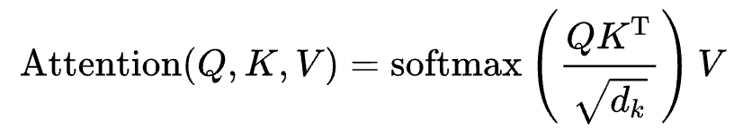
Scaled dot-product attention
FF
FF
FF
FF
Self Attention
Our input for self-attention is the matrix X which is the embeddings of the input sequence
So we call Attention(X, X, X)

Slide 26

Self-Attention
Attention(X, X, X)
q₁=x₁W_{Q}…
FF
FF
FF
FF
Self Attention
https://jalammar.github.io/illustrated-transformer/

Slide 27
Self-Attention
Attention(X, X, X)
q₁=x₁W_{Q}…
k₁=x₁W_{K}…
v₁=x₁W_{V}…
FF
FF
FF
FF
Learnable weights W_{Q}, W_{K}, W_{V}
for each attention head.
Self Attention
https://jalammar.github.io/illustrated-transformer/

Slide 28
Self-Attention
FF
FF
FF
FF
Self Attention
q₁
k₁
v₁
W_{Q}
W_{K}
W_{V}
X
x₁
x₁
x₁

Slide 29
Self-Attention
Attention(X, X, X)
Learnable weights W_{Q}, W_{K}, W_{V}
FF
FF
FF
FF
Attention of x₁ to x₂ is non-symmetric via Q, K matrices
Self Attention
https://jalammar.github.io/illustrated-transformer/

Slide 30
Self-Attention
Attention(X, X, X)
Attention of x₁ to x₂ is non-symmetric via Q, K matrices
FF
FF
FF
FF
Self Attention
W_{V} matrix learns a “useful” output for each word’s context
https://jalammar.github.io/illustrated-transformer/

Slide 31
Self-Attention
FF
FF
FF
FF
∈R
∈R
Self Attention
q₁
k₁
v₁
k₂
v₂
W_{Q}
W_{K}
W_{V}
W_{K}
W_{V}
X
x₁
x₁
x₁
x₂
x₂

Slide 32
Self-Attention
…
e
e
e
Σ
e
Σ
e
Σ
e
∈R
∈R
∈R
q₁
k₁
v₁
k₂
v₂
k₃
v₃
…
W_{Q}
W_{K}
W_{V}
W_{K}
W_{V}
W_{K}
W_{V}
x₁
x₁
x₁
x₂
x₂
x₃
x₃

Slide 33
Self-Attention
a₁
…
e
e
e
Σ
e
Σ
e
Σ
e
∈R
∈R
∈R
q₁
k₁
v₁
k₂
v₂
k₃
v₃
…
W_{Q}
W_{K}
W_{V}
W_{K}
W_{V}
W_{K}
W_{V}
x₁
x₁
x₁
x₂
x₂
x₃
x₃

Slide 34
Self-Attention
a₁
a₂
…
e
e
e
Σ
e
Σ
e
Σ
e
∈R
∈R
∈R
k₁
v₁
q₂
k₂
v₂
k₃
v₃
…
W_{K}
W_{V}
W_{Q}
W_{K}
W_{V}
W_{K}
W_{V}
x₁
x₁
x₂
x₂
x₂
x₃
x₃

Slide 35
Self-Attention
…
a₁
a₂
a₃
…
e
e
e
Σ
e
Σ
e
Σ
e
∈R
∈R
∈R
k₁
v₁
k₂
v₂
q₃
k₃
v₃
…
W_{K}
W_{V}
W_{K}
W_{V}
W_{Q}
W_{K}
W_{V}
x₁
x₁
x₂
x₂
x₃
x₃
x₃

Slide 36
Self-Attention
FF
FF
FF
FF
a₁
a₂
a₃
a₄
A(X,X,X)
Self Attention
X
x₁
x₂
x₃
x₄

Slide 37
Self-Attention
Attention(X, X, X)
q₁=x₁W_{Q}…
FF
FF
FF
FF
Self Attention
https://jalammar.github.io/illustrated-transformer/

Slide 38
Encoder-Decoder Attention
Call outputs from encoder self-attention E, decoder self-attention D
FF
FF
FF
FF
So we call Attention(D, E, E)
Enc-Dec Attention
Learnable weights W_{Q}, W_{K}, W_{V} for every attention layer in both encoder and decoder.
Multi-headed attention: multiple learnable W matrices per encoder/decoder layer, all added/softmax before FF layers.

Slide 39
Encoder-Decoder Attention
Commonly: encoder’s outputs form the keys and values, and decoder self-attn outputs are queries.
e.g., q₁=d_{1,1}W_{Q}; k₁=e₁W_{K};v₁=e₁W_{V}
FF
FF
FF
FF
Attention(D, E, E)
Enc-Dec Attention
Attention(X_{d}, X_{d}, X_{d})
d_{1,1}
e₁
Self Attention

Slide 40
Encoder-Decoder Attention
So Q queries allow relations between dec target and enc rep
Q from dec run against enc keys K and values V
FF
FF
FF
FF
Attention(D, E, E)
Enc-Dec Attention
Attention(X_{d}, X_{d}, X_{d})
d_{1,1}
e₁
Self Attention

Slide 41
Encoder-Decoder Attention
FF
FF
FF
FF
∈R
∈R
Self Attention
q₁
k₁
v₁
k₂
v₂
W_{Q}
W_{K}
W_{V}
W_{K}
W_{V}
X_{d}
x_{d1}
x_{d1}
x_{d1}
x_{d2}
x_{d2}

Slide 42
Encoder-Decoder Attention
Attention(D, E, E)
FF
FF
FF
FF
∈R
∈R
Enc-Dec Attention
q₁
k₁
v₁
k₂
v₂
W_{Q}
W_{K}
W_{V}
W_{K}
W_{V}
E
d₁
e₁
e₁
e₂
e₂
D

Slide 43
Encoder-Decoder Attention
…
a₁
a₂
a₃
…
e
e
e
Σ
e
Σ
e
Σ
e
∈R
∈R
∈R
k₁
v₁
k₂
v₂
q₃
k₃
v₃
…
W_{K}
W_{V}
W_{K}
W_{V}
W_{Q}
W_{K}
W_{V}
e₁
e₁
e₂
e₂
d₃
e₃
e₃

Slide 44
Encoder-Decoder Attention
FF
FF
FF
FF
a₁
a₂
a₃
a₄
Attention(D, E, E)
Enc-Dec Attention
Attention(X_{d}, X_{d}, X_{d})
d_{1,1}
e₁
Self Attention
Attention Is All You Need

Slide 45
Deeper Encoders / Decoders
FF
FF
FF
FF
{1, 2, 3, 4}
FF
FF
FF
FF
Enc-Dec Attention
Decoder
Self Attention
Self Attention
FF
FF
FF
FF
FF
FF
FF
FF
Encoder
Enc-Dec Attention
Self Attention
Self Attention
{a, b, c, d}

Slide 46
Relationship to Global Soft Attention
s(h_{d}) = 𝜎(xW + b)
999
893
x=
<S>
شجرتان
shajaratan
Attention(H_{d1}, H_{e}, H_{e})
Σ_{i=1…L}h_{ei}exp(a(h_{d1},h_{ei}))
s(h_{d})
s(h_{d})
Decoder D hidden state h_{d}
[Σ_{j=1…L}exp(a(h_{d1},h_{ej}))]
RNN
RNN
RNN
RNN
RNN
RNN
RNN
e
e
e
e
e
Σ
e
Σ
e
Σ
e
Σ
e
Σ
e
Embedding Layer V_{e}(t)
999
128
137
783
998
a=FC(h_{d1},h_{e1})
a=FC(h_{d1},h_{e2})
a=FC(h_{d1},h_{e3})
a=FC(h_{d1},h_{e4})
a=FC(h_{d1},h_{e5})
<S>
two
trees
sway
<E>

Slide 47
Relationship to Global Soft Attention
Global Soft Attention: Attention(H_{d1}, H_{e}, H_{e})
Stack last decoder hidden state into a Query tensor because we use it to query each Key, the encoder hidden states at each timestep, to get a weighted Value, the encoder hidden states at each timestep
Transformer Encoder-Decoder Attention: Attention(D, E, E)
Decoder self-attention Query to encoder self-attention Keys to get weighted encoder self-attention Values
Key difference: in the Transformer decoder, we have access to multiple timesteps because Transformers operate on sets!

Slide 48
Self-Attention Intuitions
Transformer Encoder Self Attention: Attention(X_{i}, X_{i}, X_{i})
How the words in the input sequence relate to one another
Query how each word relates to the Keys of other words in the set (and itself), to get weighted Value of each words’ representation with respect to others in the sequence
Key takeaway: in self-attention, we encode the entire set of tokens with respect to one another, ending with a size L set of self-conditioned embeddings

Slide 49
Self-Attention Intuitions
Transformer Decoder Self Attention: Attention(X_{o}, X_{o}, X_{o})
How the words in the output sequence relate to one another
Query how each word relates to the Keys of other words in the set (and itself), to get weighted Value of each words’ representation with respect to others in the sequence
Key takeaway: In a Transformer, we have access to the input and output sets at encoding time, so the decoder self-attention can create a latent embedding too

Slide 50
How Would We Train a Transformer?
{1, 2, 3, 4}
Say we want to learn something really easy
a->1, b->2, …
Inputs: sets of letters
Outputs: sets of numbers
{1, 2, 3, 4}
Decoder
What will this architecture learn?
To copy the decoder input to the output channel directly!
Doesn’t need input
Encoder
{a, b, c, d}

Slide 51
Supervision: Masking
{1, 2, 3, 4}
Loss
{1, 2, ∅, 4}
Decoder
Encoder
{a, b, c, d}

Slide 52
Supervision: Masking
Learn to recover missing elements of the target output sequence conditioned on information from the input.
FF
FF
FF
FF
Attention(D, E, E)
Enc-Dec Attention
Attention(X_{d}, X_{d}, X_{d})
d_{1,1}
e₁
Self Attention

Slide 53
Sequences
[1, 2, 3, 4]
What if we want our input/output to be sequences?
E.g., sentences!
Prev:
{a, c, d} -> {4, 3, 1},
Want:
[a, c, d] -> [1, 3, 4]
Decoder
Encoder
[i1, i2, i3, i4]
[a, b, c, d]

Slide 54
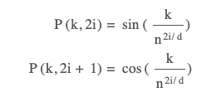
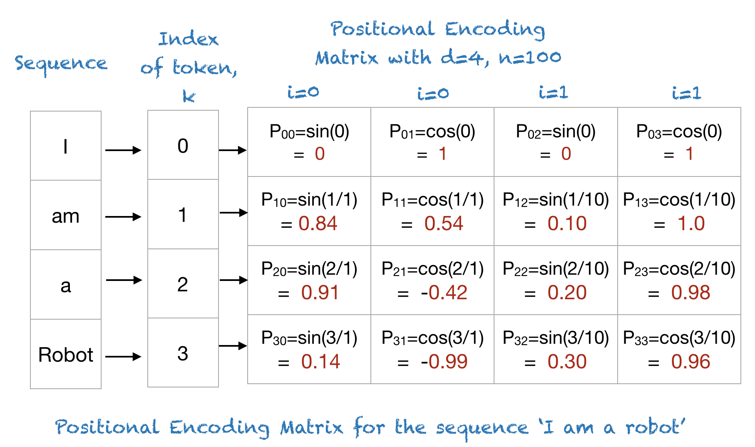
Sequences: What is a Positional Encoding?
[1, 2, 3, 4]
Creating a consistent “indicator vector” for each position
“Nearness” between adjacent positions preserved by encoding functions.
Decoder
cos(p(0), p(1)) = 0.77
Encoder
cos(p(0), p(2)) = 0.28
cos(p(1), p(2)) = 0.77
cos(p(0), p(3)) = -0.01
cos(p(1), p(3)) = 0.28
cos(p(2), p(3)) = 0.77
[i1, i2, i3, i4]
[a, b, c, d]
https://machinelearningmastery.com/a-gentle-introduction-to-positional-encoding-in-transformer-models-part-1/

Slide 55
Positional Encodings
cos(p(1), p(2)) = 0.77
Assume: W_{Q} and W_{K} matrix transformations preserve distance.
Then in general:
q₁*k₂ > q₁*k₃
Positional encodings bias the attention mechanism to give more weight to adjacent words without respect to the words themselves
x₁
=e_{x1}
+p₁
cos(p(1), p(3)) = 0.28
cos(p(1), p(4)) = -0.01
…
e
e
e
Σ
e
Σ
e
Σ
e
∈R
∈R
∈R
q₁
k₁
v₁
k₂
v₂
k₃
v₃
…
W_{Q}
W_{K}
W_{V}
W_{K}
W_{V}
W_{K}
W_{V}
x₁
x₁
x₁
x₂
x₂
x₃
x₃

Slide 56
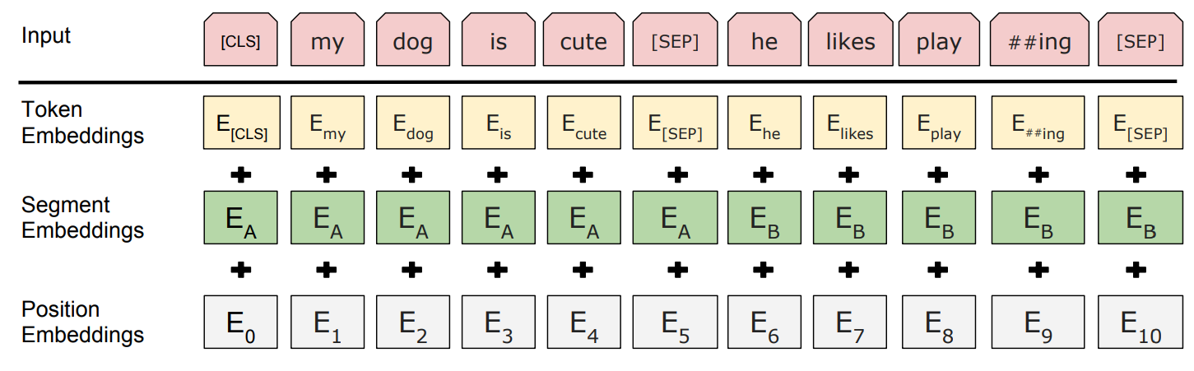
Bidirectional Encoder Representations from Transformers
BERT: Pre-training of Deep Bidirectional Transformers for Language Understanding

Slide 57
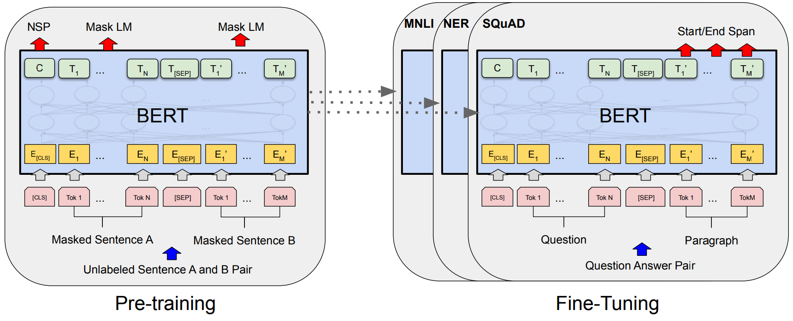
Bidirectional Encoder Representations from Transformers
BERT: Pre-training of Deep Bidirectional Transformers for Language Understanding

Slide 58
Masked Language Modeling Pretraining
15% of words selected for training
[MASK]
PEEL
[MASK]
PLAY
80% of those [MASK]
10% random token
10% original token
BERT: Pre-training of Deep Bidirectional Transformers for Language Understanding

Slide 59
Masked Language Modeling Pretraining
dog
cute
he
play
FC+softmax
FC+softmax
FC+softmax
FC+softmax
Transformer w Self-Attention
…
Transformer w Self-Attention
Embedding Layer [Token, Position]
[CLS]
my
dog
is
cute
[SEP]
[MASK]
PLAY
[MASK]
PEEL
he
likes
play
##ing
##le
[SEP]
BERT: Pre-training of Deep Bidirectional Transformers for Language Understanding

Slide 60
Bidirectional Encoder Representations from Transformers
BERT: Pre-training of Deep Bidirectional Transformers for Language Understanding

Slide 61
Masked Language Modeling Pretraining
Next Sentence Follows?
dog
cute
he
play
FC+softmax₂
FC+softmax
FC+softmax
FC+softmax
FC+softmax
Transformer w Self-Attention
…
Transformer w Self-Attention
Embedding Layer [Token, Position]
[CLS]
my
dog
is
cute
[SEP]
[MASK]
PLAY
[MASK]
PEEL
he
likes
play
##ing
##le
[SEP]
BERT: Pre-training of Deep Bidirectional Transformers for Language Understanding

Slide 62
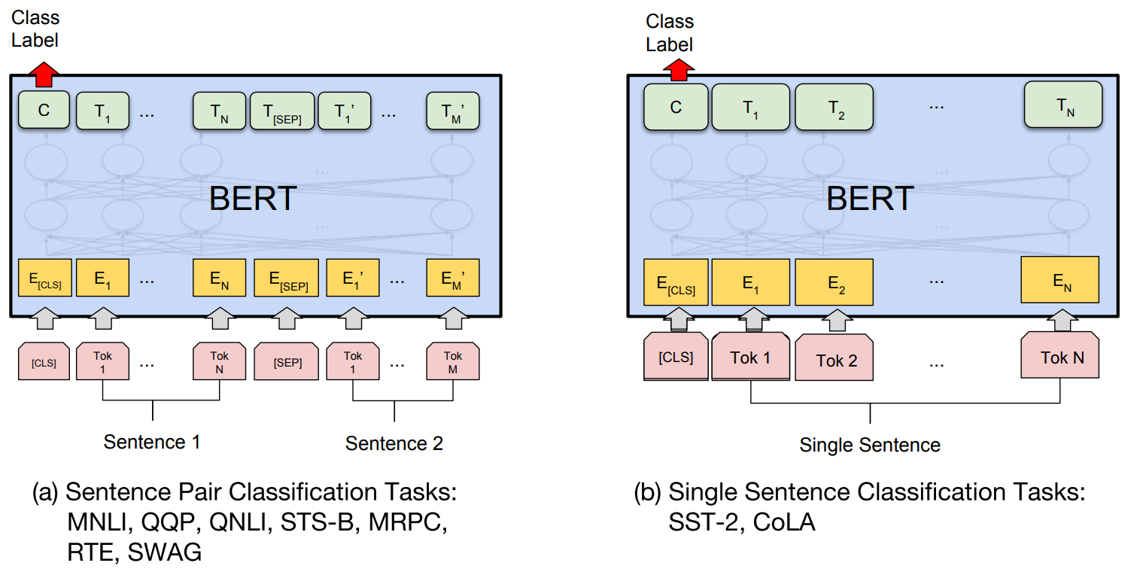
Bidirectional Encoder Representations from Transformers
BERT: Pre-training of Deep Bidirectional Transformers for Language Understanding

Slide 63
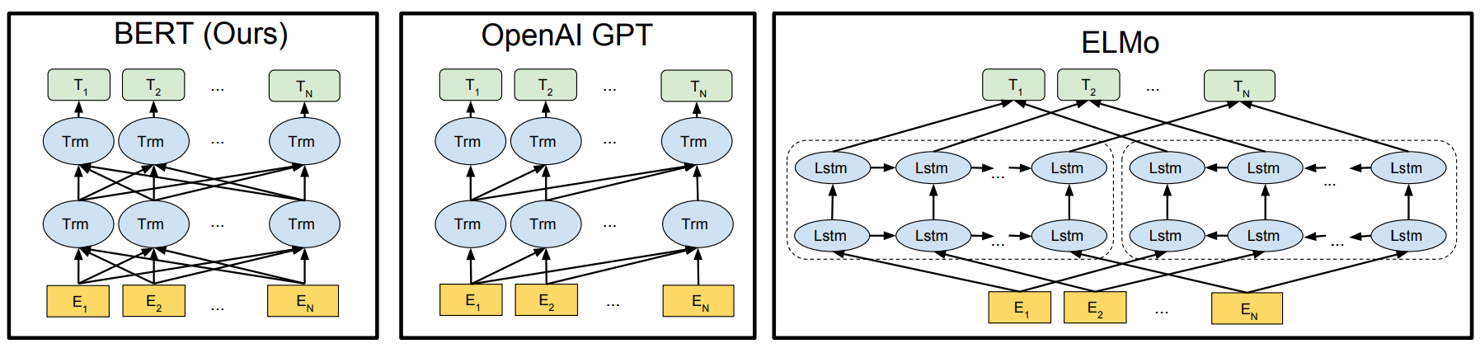
Bidirectional versus Autoregressive
BERT: Pre-training of Deep Bidirectional Transformers for Language Understanding

Slide 64
Supervision: Sequences
[1]
Loss
Left-to-right masking of decoder input
On each run, predict the next token.
Need position information for decoder inputs as well.
[∅, ∅, ∅, ∅]
Decoder
Encoder
[i1, i2, i3, i4]
[a, b, c, d]

Slide 65
Supervision: Sequences
[1, 2]
Loss
[1, ∅, ∅, ∅]
Decoder
Encoder
[i1, i2, i3, i4]
[a, b, c, d]

Slide 66
Supervision: Sequences
[1, 2]
Loss
In practice, decoder inputs will be previous timestep outputs.
Related to general language modeling questions for decoding: sampling, beam search, etc.
[1, ∅, ∅, ∅]
Decoder
Encoder
[i1, i2, i3, i4]
[a, b, c, d]

Slide 67

Supervision: Sequences
https://jalammar.github.io/illustrated-transformer/

Slide 68

Supervision: Sequences
https://jalammar.github.io/illustrated-transformer/

Slide 69
Sequence-to-Sequence Transformer
A
Enc-Dec Attention [Attn(D, E, E)]
E
D
Self-Attention [Attn(V_{e}(T), V_{e}(T), V_{e}(T))]
Self-Attention [Attn(V_{d}(T’), V_{d}(T’), V_{d}(T’))]
Embedding Layer V_{e}(t) + P(t)
Embedding Layer V_{d}(t’) + P(t)
999
128
137
783
998
0
0
0
0
0
T
<S>
two
trees
sway
<E>
T’
∅
∅
∅
∅
∅

Slide 70
Sequence-to-Sequence Transformer
893
شجرتان
shajaratan
s(a₂)
A
Enc-Dec Attention [Attn(D, E, E)]
E
D
Self-Attention [Attn(V_{e}(T), V_{e}(T), V_{e}(T))]
Self-Attention [Attn(V_{d}(T’), V_{d}(T’), V_{d}(T’))]
Embedding Layer V_{e}(t) + P(t)
Embedding Layer V_{d}(t’) + P(t)
999
128
137
783
998
999
0
0
0
0
T
<S>
two
trees
sway
<E>
T’
<S>
∅
∅
∅
∅

Slide 71
Sequence-to-Sequence Transformer
489
تتمايلان
tatamayalan
s(a₃)
A
Enc-Dec Attention [Attn(D, E, E)]
E
D
Self-Attention [Attn(V_{e}(T), V_{e}(T), V_{e}(T))]
Self-Attention [Attn(V_{d}(T’), V_{d}(T’), V_{d}(T’))]
Embedding Layer V_{e}(t) + P(t)
Embedding Layer V_{d}(t’) + P(t)
999
128
137
783
998
999
893
0
0
0
T
<S>
two
trees
sway
<E>
T’
<S>
شجرتان
shajaratan
∅
∅
∅

Slide 72
Sequence-to-Sequence Transformer
998
<E>
s(a₄)
A
Enc-Dec Attention [Attn(D, E, E)]
E
D
Self-Attention [Attn(V_{e}(T), V_{e}(T), V_{e}(T))]
Self-Attention [Attn(V_{d}(T’), V_{d}(T’), V_{d}(T’))]
Embedding Layer V_{e}(t) + P(t)
Embedding Layer V_{d}(t’) + P(t)
999
128
137
783
998
999
893
489
0
0
T
<S>
two
trees
sway
<E>
T’
<S>
شجرتان
shajaratan
تتمايلان
tatamayalan
∅
∅

Slide 73
Sequence-to-Sequence Transformer
893
489
998
A
شجرتان
shajaratan
تتمايلان
tatamayalan
<E>
Enc-Dec Attention [Attn(D, E, E)]
E
D
Self-Attention [Attn(V_{e}(T), V_{e}(T), V_{e}(T))]
Self-Attention [Attn(V_{d}(T’), V_{d}(T’), V_{d}(T’))]
Embedding Layer V_{e}(t) + P(t)
Embedding Layer V_{d}(t’) + P(t)
999
128
137
783
998
999
893
489
0
0
T
<S>
two
trees
sway
<E>
T’
<S>
شجرتان
shajaratan
تتمايلان
tatamayalan
∅
∅

Slide 74
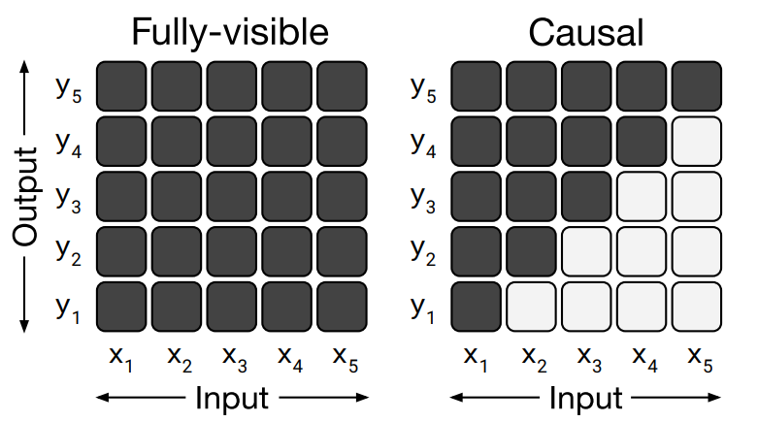
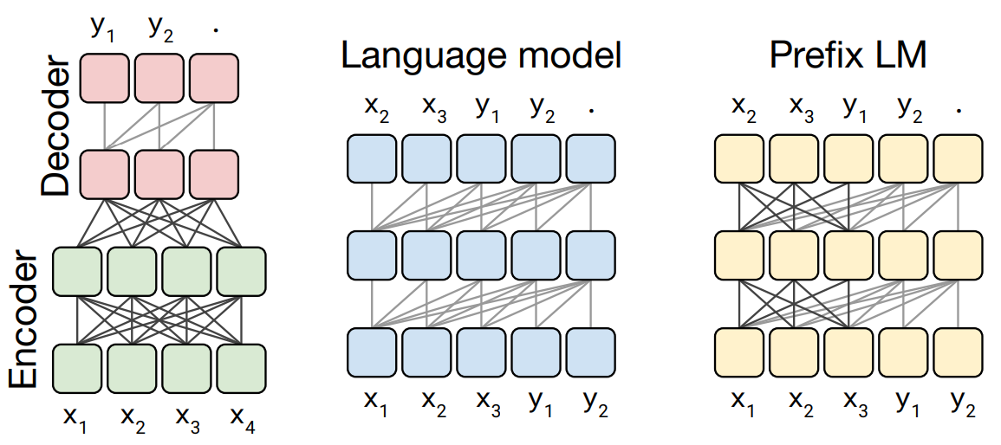
Redundant Terminology
Autoregressive -> left-to-right; causal (e.g., GPT)
Bidirectional -> fully-visible (e.g., BERT)
What differences do you see here for Enc/Dec vs LM vs Pref LM?
Exploring the Limits of Transfer Learning with a Unified Text-to-Text Transformer

Slide 75
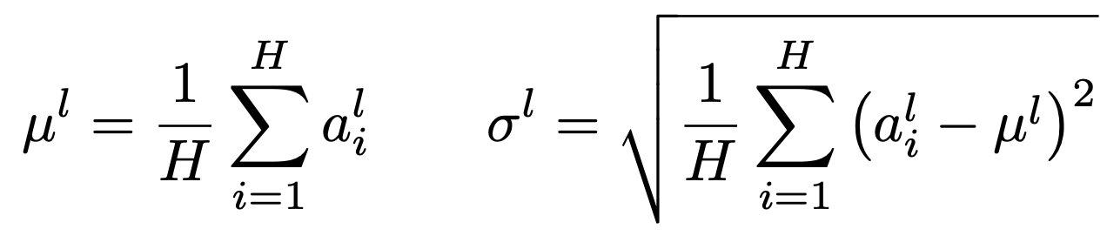
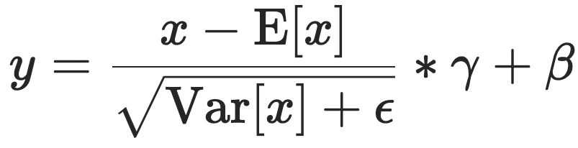
INDUSTRY PRACTICE: Layer Normalization
Like BatchNorm, except compute the estimated mean and variance of the activations of a neurons in a single layer
Learnable ɣ, β vectors; more stability and faster convergence
Same operation at training and inference time
Has become industry standard to include LayerNorm between stacked Transformer layers
Layer Normalization (original paper and method); On Layer Normalization in the Transformer Architecture

Slide 76
Transformers: The Future of the Present
Transformers seem like they might be the universal encoders we’ve been waiting for in multimodal space
Language tokens, image regions, image patches, audio snippets, joint positions, transformers don’t care!
We’ll keep talking about Transformers next time with Deep Learning for Multimodality and Agents

Slide 77
Overview of Today’s Plan
Course organization and deliverables
Transformers
Any questions before we move on?
DL for Computer Vision
Midterm Debrief

Slide 78
Deep Learning and Machine Vision
The resurgence in popularity of Deep Learning started in vision
AlexNet!
In our lectures on CNNs, we covered some “classic” CV problems like image classification
Object detection is similar, but typically involves identifying “regions of interest” where an object might live
For today’s focus, I want to move towards the “flashier” half of input/output relationships in computer vision

Slide 79
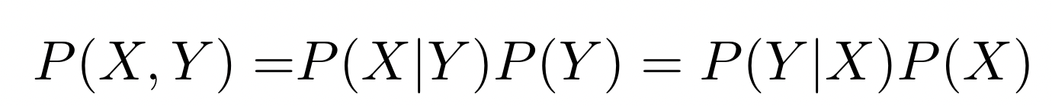
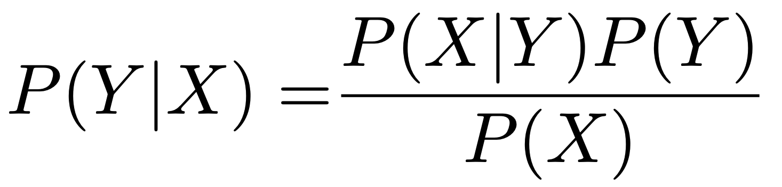
ML FUNDAMENTALS: Discriminative v. Generative
Bayes’ Rule
Likelihood of Y
Prior of Y
Posterior of Y
Discriminative Estimate P(Y|X) from data.
E.g., {f(x)=y} ↔ {p(y|x)}
Generative Estimate P(X|Y) and P(Y) from data.
E.g., {f(x)=y} ↔ {p(y) occurs and p(x|y) that y explains observed x}

Slide 80
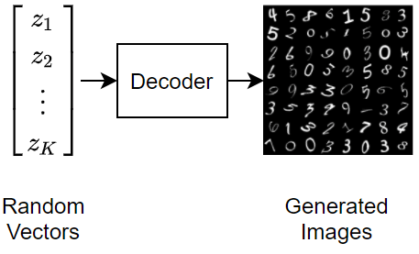
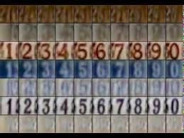
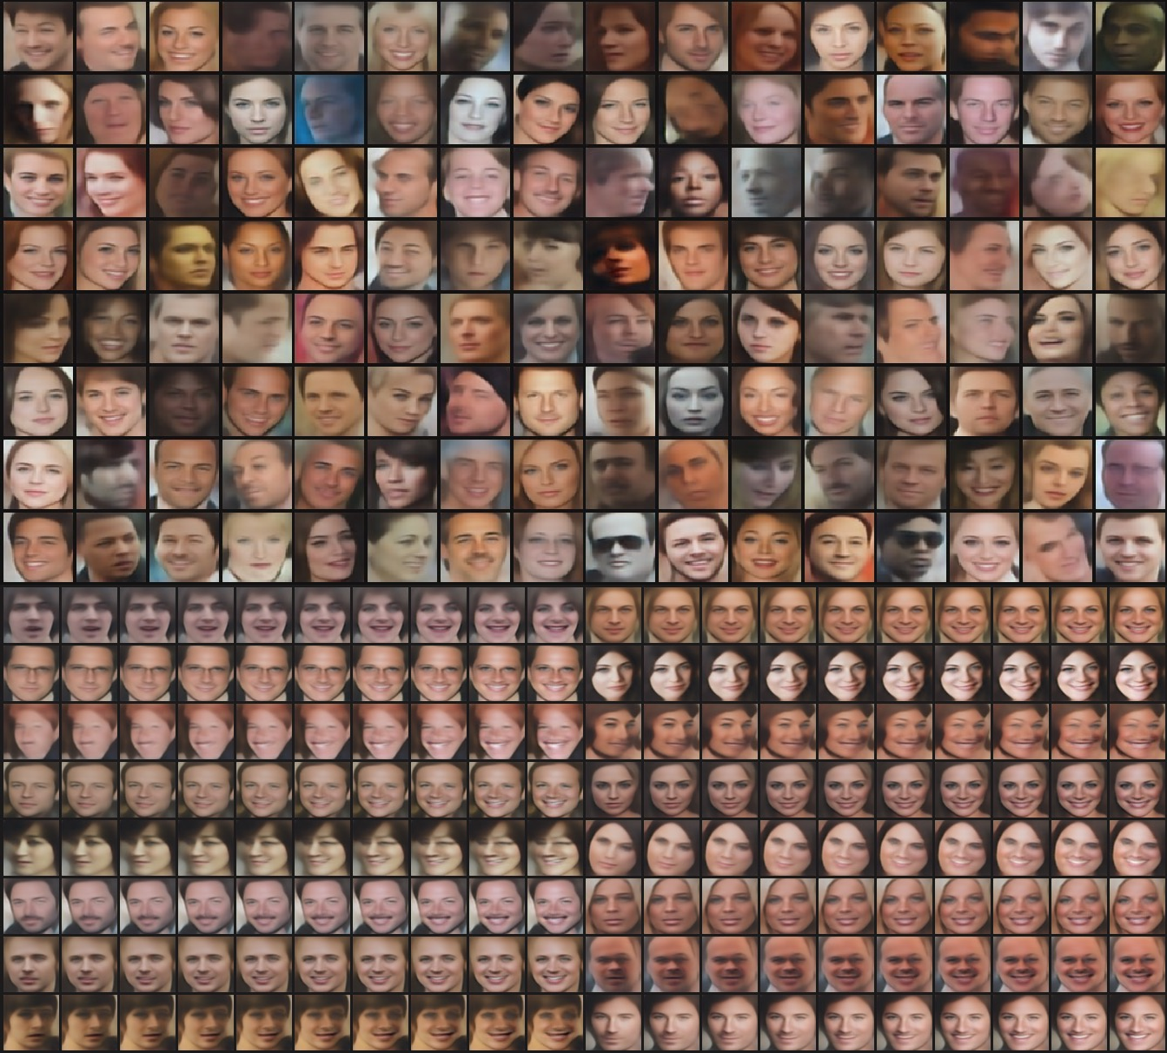
Deep Generative Modeling for Computer Vision

Slide 81
Autoencoder
That word embeddings are a learned compression of co-occurrence matrices for tokens is part of a larger trend
One can formulate deep learning models to be learned compression algorithms for a given input space
Autoencoding is unsupervised:
Given input of size X, shrink to size x<X with learned function (encoder) and unshrink it back to X with a another learned function (decoder)
Autoencoders learn a lower dimensional manifold for input

Slide 82
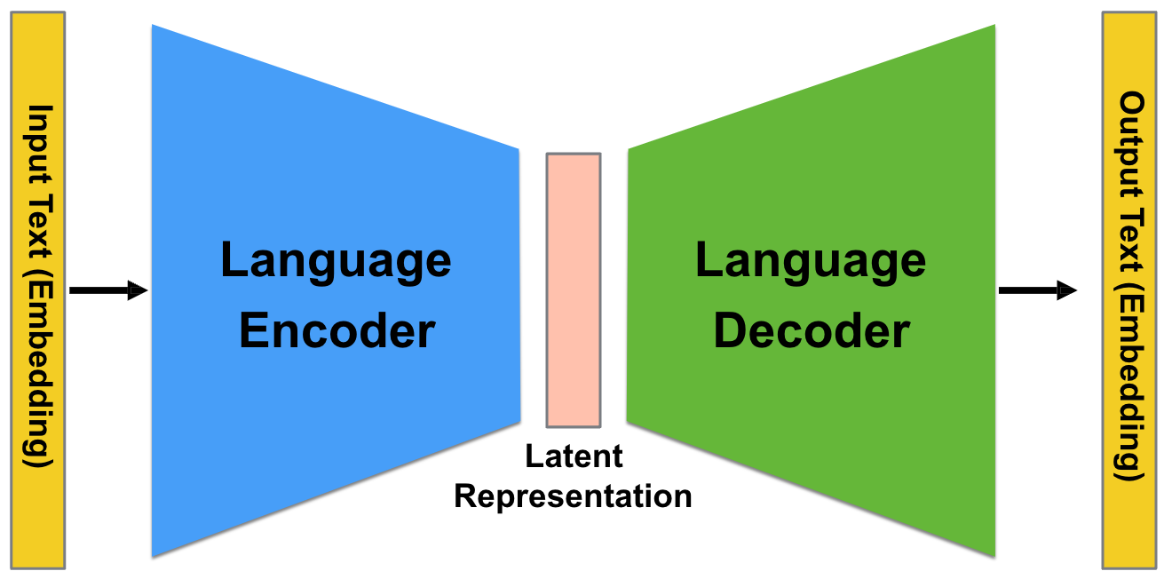
Autoencoder
The latent tensor from the encoder is a compressed representation to be decoded/decompressed.
A
Enc-Dec Attention [Attn(D, E, E)]
E
D
Self-Attention [Attn(V_{e}(T), V_{e}(T), V_{e}(T))]
Self-Attention [Attn(V_{d}(T’), V_{d}(T’), V_{d}(T’))]
Embedding Layer V_{e}(t) + P(t)
Embedding Layer V_{d}(t’) + P(t)

Slide 83
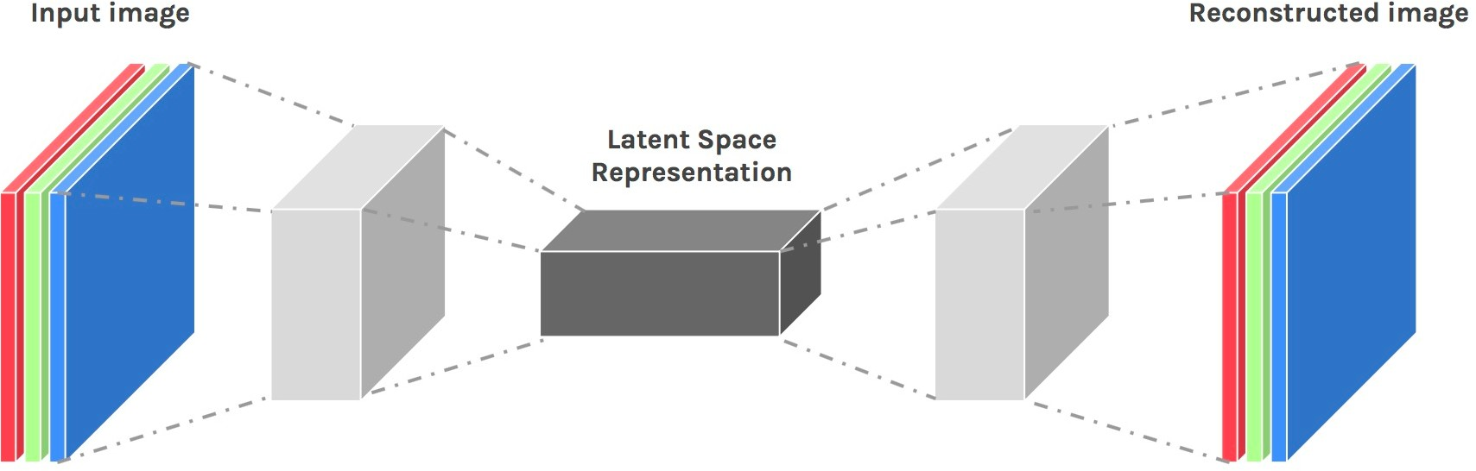

Autoencoder
The latent tensor from the encoder is a compressed representation to be decoded/decompressed.
Encoding
Decoding

Slide 84
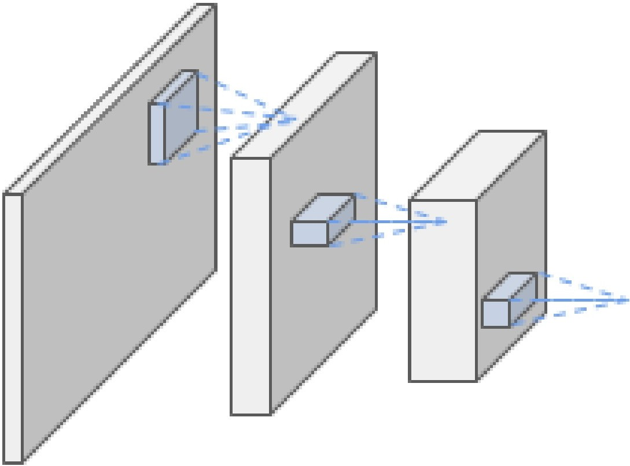
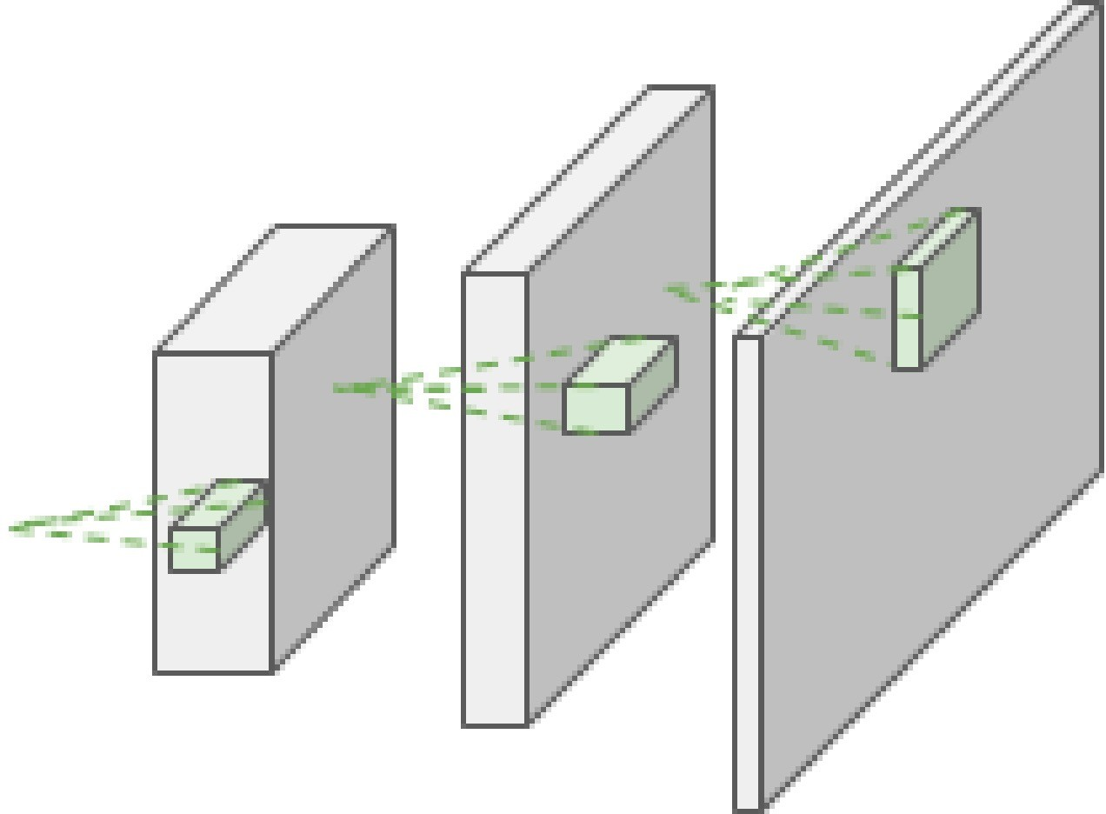
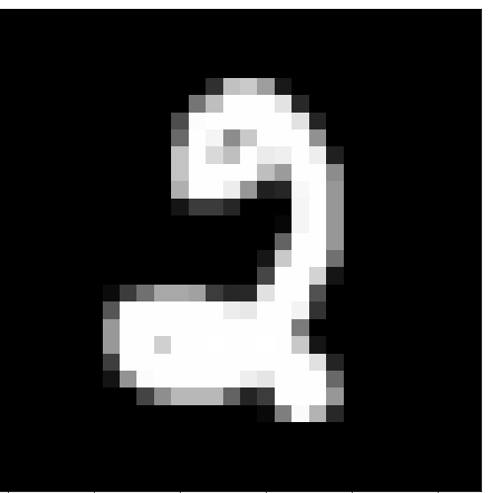
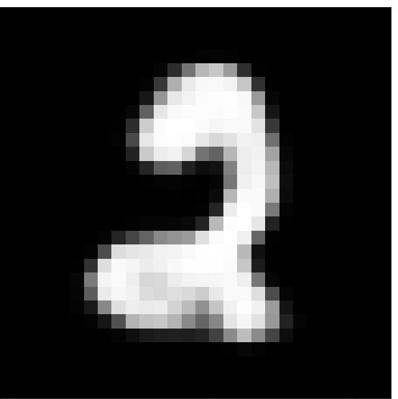

CNN Autoencoder
Reconstruction Loss L(x, x’)
Input x
Encoder
f_{e}(x;θ_{e})=z
Latent z
Decoder
f_{d}(z;θ_{d})=x’
Reconstructed input x’

Slide 85
Autoencoder Encoder As Feature Representation
.01 | 0
.03 | 1
.63 | 2
.11 | 3
… | …
FC+𝝈
Like word embeddings, autoencoder representations are compact manifolds for the input that capture salient information (in this case, what’s needed to reconstruct)

Slide 86
Autoencoder Decoder As Data Generator
What if we sample vector z’ as draws from a Gaussian?
Will we achieve reconstructions that look like our input data X?
No! Our data X encodes to a particular manifold in R^{|z|}

Slide 87
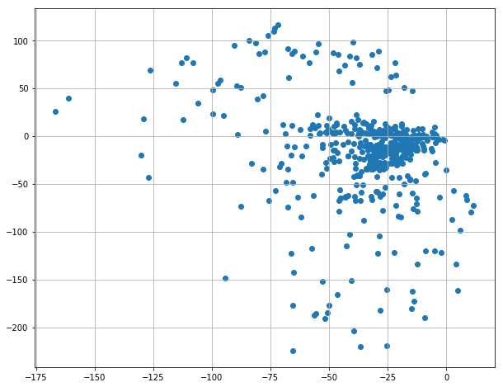


Autoencoder Decoder As Data Generator
Manifold X:
Sampled z’
Sampled z’
What if we sample vector z’ as draws from a Gaussian?
Will we achieve reconstructions that look like our input data X?
No! Our data X encodes to a particular manifold in R^{|z|}

Slide 88
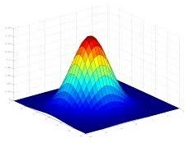
Autoencoder Decoder As Data Generator
What if we make the latent manifold Gaussian?
By reformulating the nature of the latent space and adding some additional regularizing loss, we can.

Slide 89
Variational Autoencoder
Latent Space Loss L_{G}(z_{μ}, z_{𝜎})
Reconstruction Loss L_{R}(x, x’)
Latent z_{μ}
Latent z_{𝜎}
Input x
Encoder
f_{e}(x;θ_{e})=(z_{μ}, z_{𝜎})
Decoder
f_{d}(z_{μ}+εz_{𝜎};θ_{d})=x’
Reconstructed input x’
We learn a mean and variance for the latent manifold for every input, then constrain those to be Gaussian

Slide 90
Variational Autoencoder
Reconstruction Loss L_{R}(x, x’)
Typically mean-squared error loss (for images)
For language, could be cross entropy over decoded tokens
Enforces that learned decoder function f_{d}(z_{μ}+εz_{𝜎};θ_{d}) is a good approximation of p(x|z) for x the original input and z the learned latent manifold vector obtained from f_{e}(x)

Slide 91
Variational Autoencoder
Latent Space Loss L_{G}(z_{μ}, z_{𝜎})
Typically KL divergence between encoder outputs f_{e}(x;θ_{e}) and the ideal Gaussian distribution we want latent space in
Note that f_{e}(x;θ_{e}) approximates p(z|x), and the goal of this loss is to drive p(z) towards a Gaussian, e.g., N(0, 1)
Without going into deep detail, the KL divergence of P from Q is the expected excess surprise from using Q as a model when the actual distribution is P.
L_{G}(z_{μ}, z_{𝜎}) = KL(N(z_{μ}, z_{𝜎}), N(0, 1))

Slide 92
Variational Autoencoder
Latent Space Loss L_{G}(z_{μ}, z_{𝜎})
Reconstruction Loss L_{R}(x, x’)
Latent z_{μ}
Latent z_{𝜎}
Input x
Encoder
f_{e}(x;θ_{e})=(z_{μ}, z_{𝜎})
Decoder
f_{d}(z_{μ}+εz_{𝜎};θ_{d})=x’
Reconstructed input x’
We have one small hiccup yet.
Does the above network define a function?

Slide 93
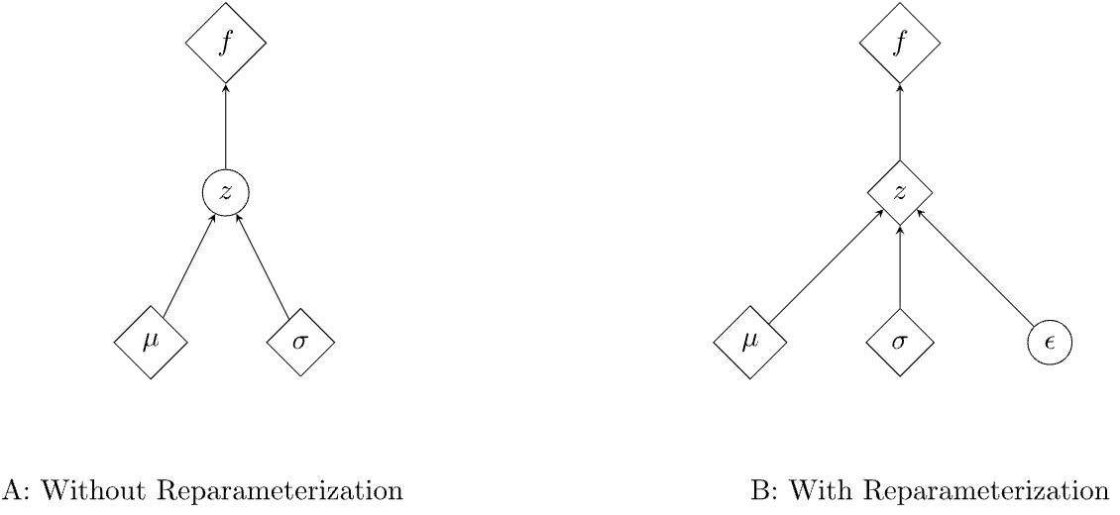
Variational Autoencoder
Latent Space Loss L_{G}(z_{μ}, z_{𝜎})
Reconstruction Loss L_{R}(x, x’)
Latent z_{μ}
Input x
Latent z_{𝜎}
ε
Encoder
f_{e}(x;θ_{e})=(z_{μ}, z_{𝜎})
Decoder
f_{d}(z_{μ}+εz_{𝜎};θ_{d})=x’
Reconstructed input x’
Input ε~N(0,1)
The Reparameterization Trick in Variational Autoencoders

Slide 94
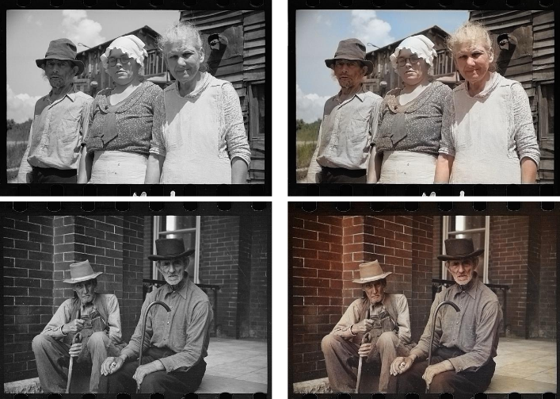
Autoencoder Decoder For Downstream Tasks
Initialize decoder from autoencoder process
Fine tune to recover missing information, such as grayscale (single channel) to RGB (3 channel)
https://developer.nvidia.com/blog/automatic-image-colorization-of-grayscale-images/

Slide 95
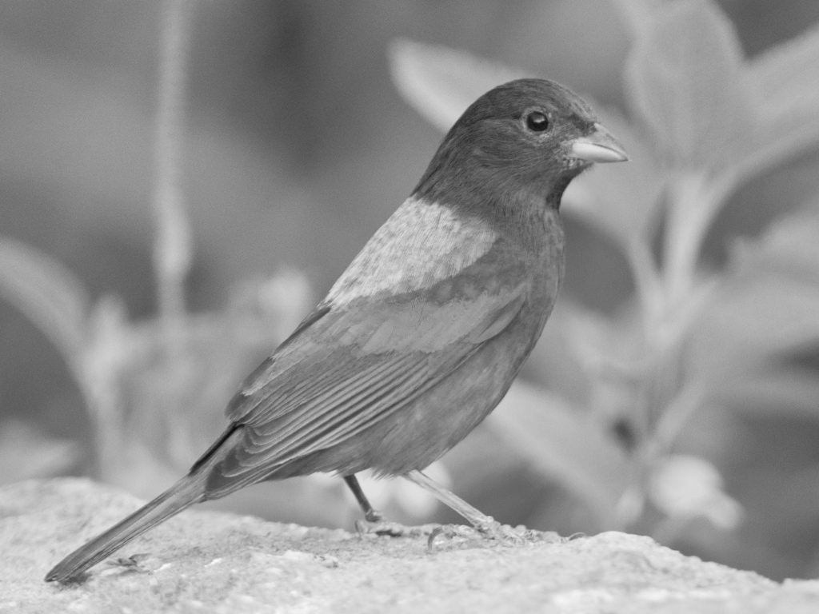
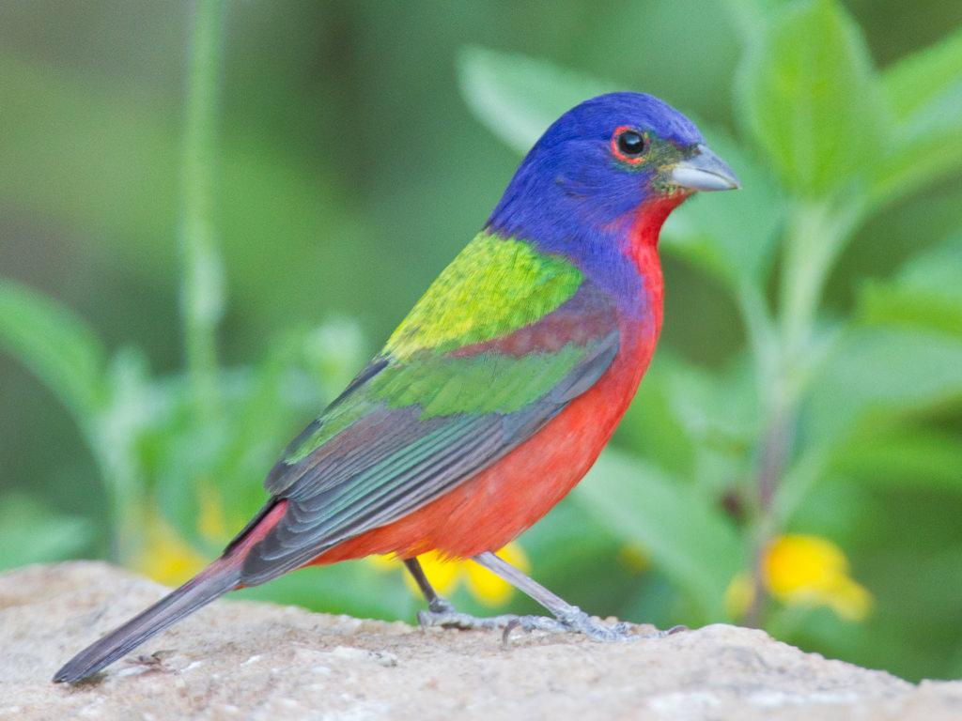
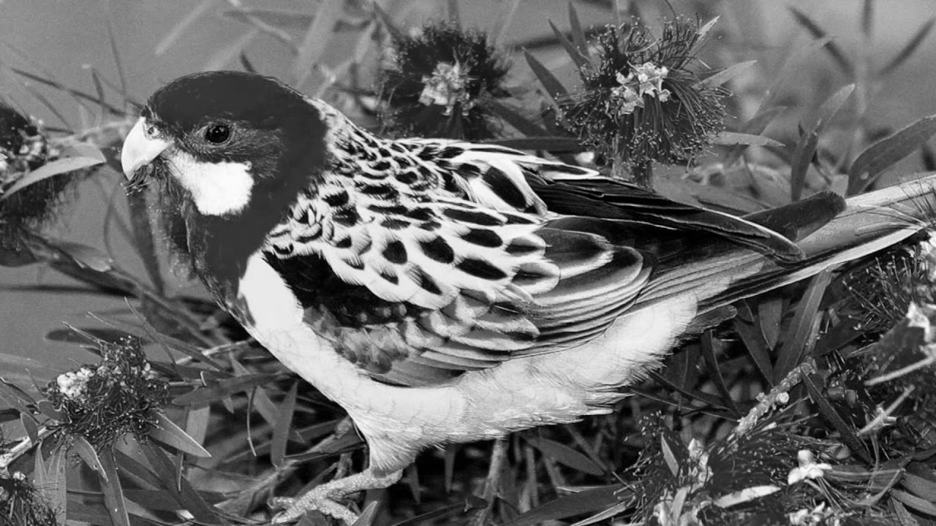
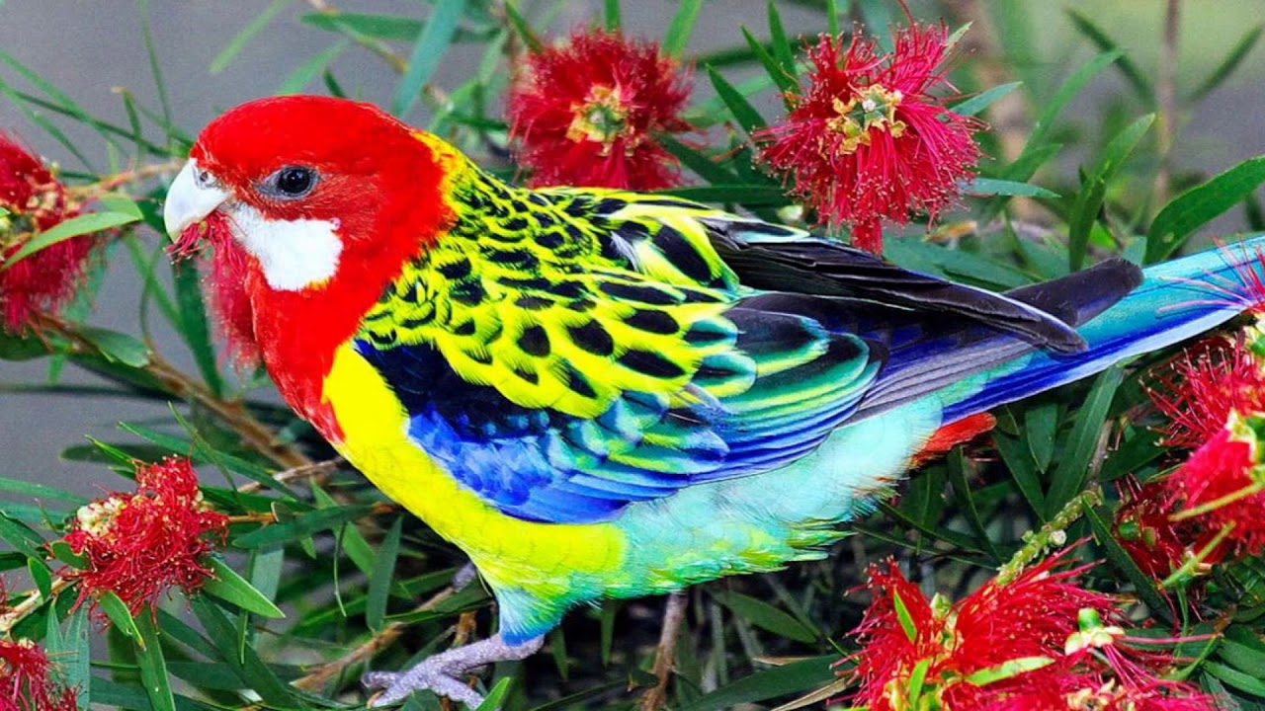
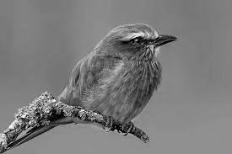
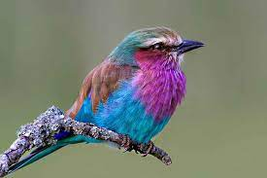
Autoencoder Decoder For Downstream Tasks

Slide 96
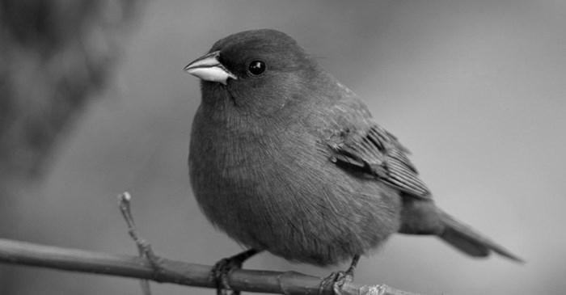
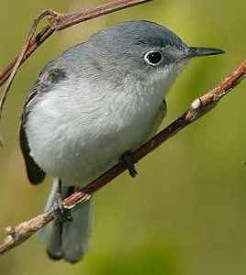
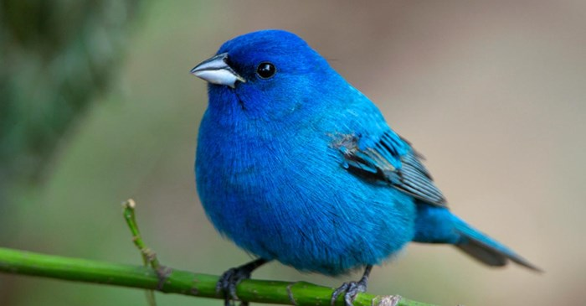
Variational Autoencoder Mode Collapse
Minimizing reconstruction loss means defaulting to averages for high variance tasks like “coloring a bird”
Average minimizes the loss but never gets the right color!
How can we penalize taking these “safe bet” local minima?

Slide 97
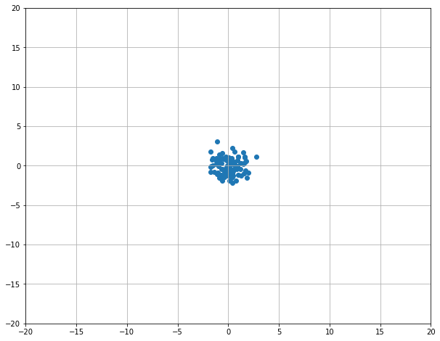
Generative Adversarial Networks
D(·)=1
D(·)=1
D(·)=0
D(·)=1
Rand N(0, 1)
Generator f(z) -> x’
Generator Network
Gen Images
Train Images
Rand z
Decoder
f_{d}(z;θ_{d})=x’
Upsampled x’
Discriminator D(x’) -> 0
Discriminator D(x) -> 1
Discriminator Network D
Discriminator Network D
Real/Fake Decision
Real/Fake Decision

Slide 98
Overview of Today’s Plan
Course organization and deliverables
Transformers
DL for Computer Vision
Any questions before we move on?
Midterm Debrief

Slide 99
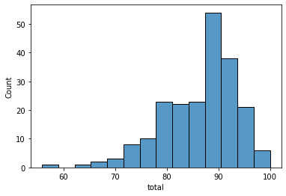
Midterm
(μ=86.5; 𝜎=7.2); median=88.8
Today, we’ll go over the 10 most popular incorrect answers.

Slide 100
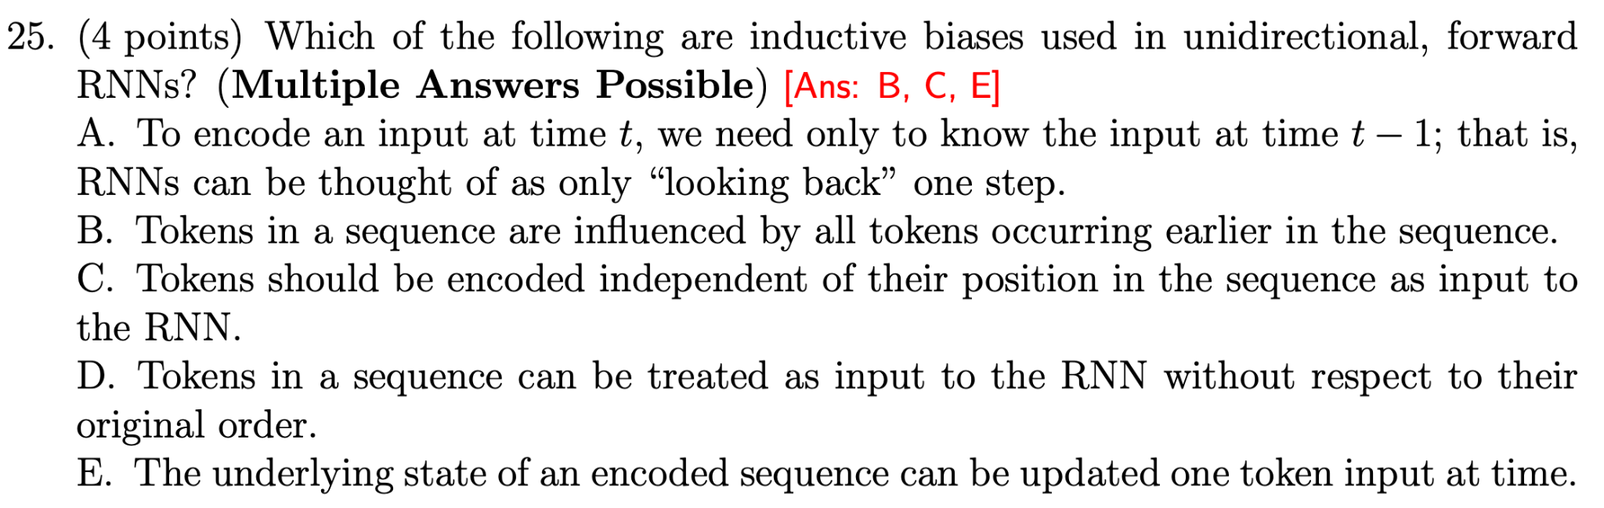
Midterm: Most Missed Questions

Slide 101
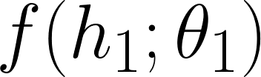
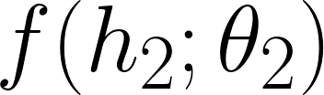
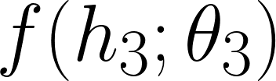
Sequence Modeling with Learned Neural Functions [Lecture 5]
y₁
y₂
y₃
y₄
h₁
h₂
h₃
h₄
We can learn functions: f: h->h f: x->h f: h->y That are each independent of the timestep dimension.
x

Slide 102
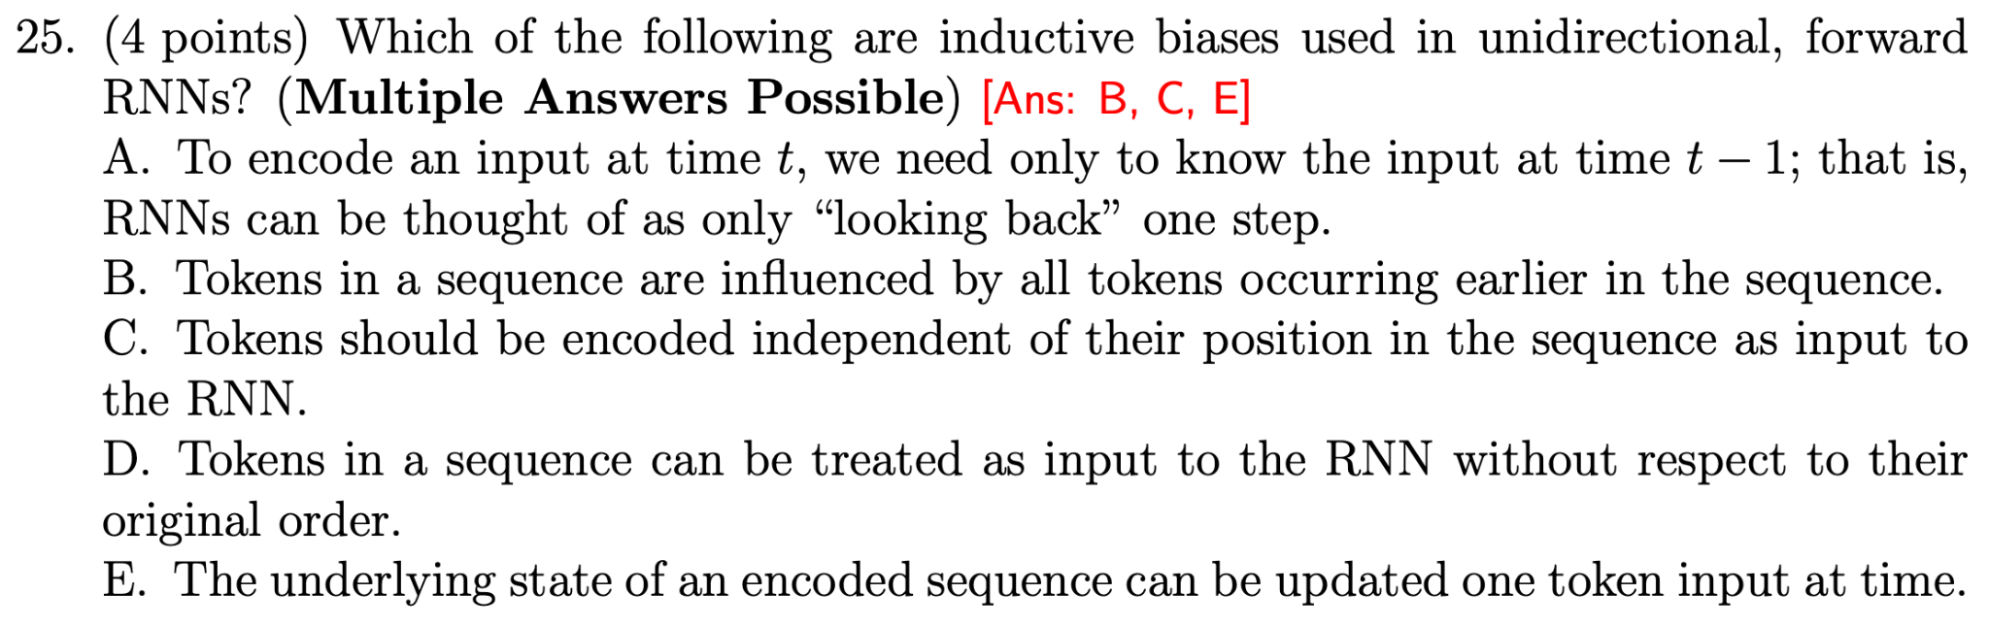
Midterm: Most Missed Questions

Slide 103
High Level Computation Graph for RNN [Lecture 5]
l₁=L(y₁, *y₁)
l₂=L(y₂, *y₂)
l₃=L(y₃, *y₃)
y₁
y₂
y₃
y₁=𝝈(W_{h→y}h₁)
y₂=𝝈(W_{h→y}h₂)
y₃=𝝈(W_{h→y}h₃)
h₀
h₁
h₂
h₃
h₁=tanh(W_{h→h}h₀+W_{x→h}x₁)
h₂=tanh(W_{h→h}h₁+W_{x→h}x₂)
h₃=tanh(W_{h→h}h₂+W_{x→h}x₃)
x₁
x₂
x₃

Slide 104
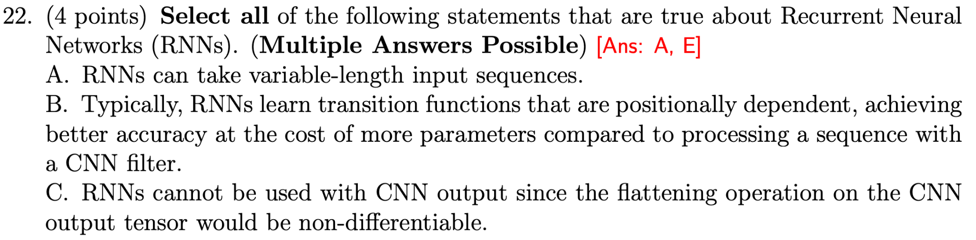
Midterm: Most Missed Questions

Slide 105
Sequence Modeling with Learned Neural Functions [Lecture 5]
y₁
y₂
y₃
y₄
h₁
h₂
h₃
h₄
We can learn functions: f: h->h f: x->h f: h->y That are each independent of the timestep dimension.
x

Slide 106
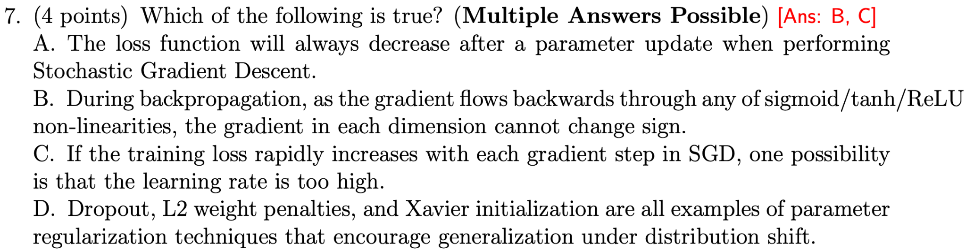
Midterm: Most Missed Questions

Slide 107
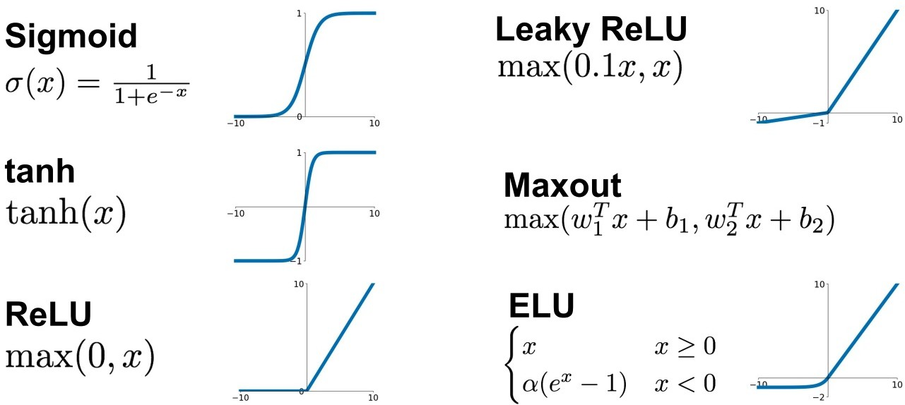
Activation Functions [Lecture 4]
These activation functions are monotonically non-decreasing; their gradient is never negative.

Slide 108
Midterm: Most Missed Questions
Xavier (Glorot) initialization is not a parameter regularization technique; the motivation of Xavier and He initializations are related to training convergence, not to generalization performance [Lecture 4]

Slide 109
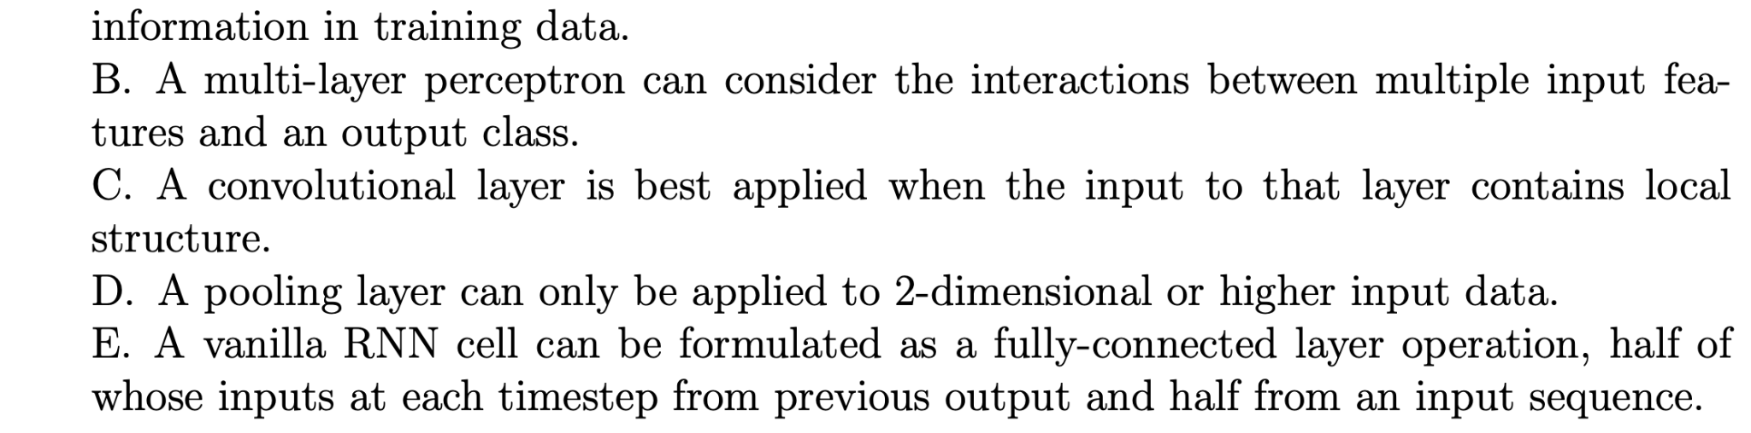
Midterm: Most Missed Questions

Slide 110
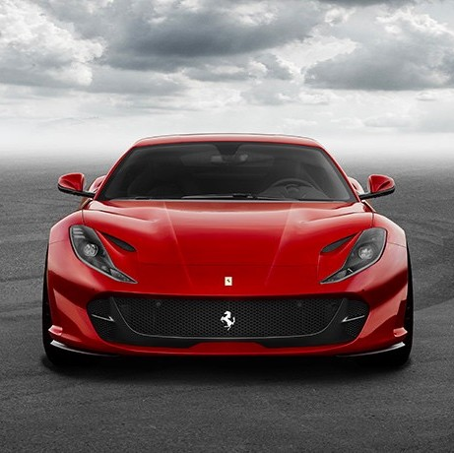
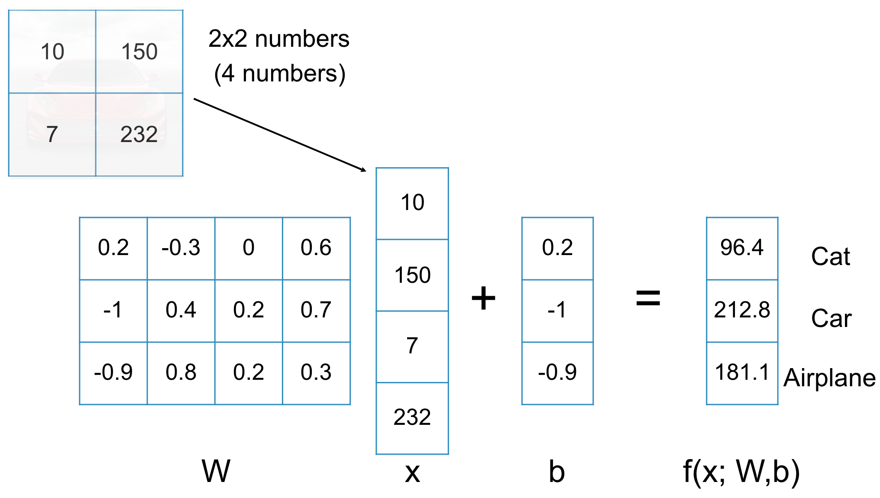
Linear Image Classification [Lecture 2]
W: how much each input feature indicates each class (e.g., p(y|x))
b: how likely each class is alone (e.g., p(y))
Great, so “Car” is the highest number. How do we get W and b though?

Slide 111
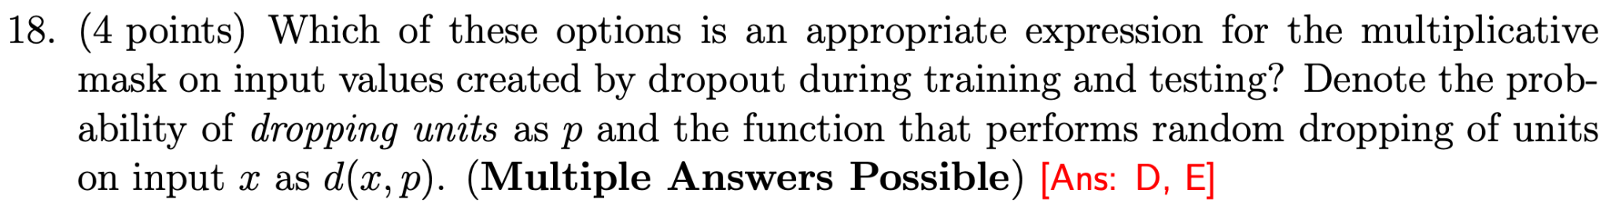

Midterm: Most Missed Questions
Need E[x] at train/test time to be the same. [Lecture 4]
D. “inverted dropout” scales train activations up.
E. “scaling activation” scales inference activations down.
Same effect! This one required some thought, rather than lookup directly.

Slide 112

Midterm: Most Missed Questions

Slide 113
Use Attention to Rewrite RNN State Input [Lecture 5]
∈R
893
a=FC(h_{d1},h_{ei})
شجرتان
shajaratan
Σ_{i=1…L}h_{ei}exp(a(h_{d1},h_{ei}))
s(h_{d})
Init decoder D hidden state h_{d1}=h_{eN}
[Σ_{j=1…L}exp(a(h_{d1},h_{ej}))]
RNN
RNN
RNN
RNN
RNN
RNN
RNN
Embedding Layer V_{d}(t)
999
<S>
Embedding Layer V_{e}(t)
999
128
137
783
998
<S>
two
trees
sway
<E>

Slide 114

Midterm: Most Missed Questions

Slide 115
Sequence Modeling with Learned Neural Functions [Lecture 5]
y₁
y₂
y₃
y₄
h₁
h₂
h₃
h₄
We can learn functions: f: h->h f: x->h f: h->y That are each independent of the timestep dimension.
x

Slide 116

Midterm: Most Missed Questions

Slide 117
High Level Computation Graph for RNN [Lecture 5]
l₁=L(y₁, *y₁)
l₂=L(y₂, *y₂)
l₃=L(y₃, *y₃)
y₁
y₂
y₃
y₁=𝝈(W_{h→y}h₁)
y₂=𝝈(W_{h→y}h₂)
y₃=𝝈(W_{h→y}h₃)
h₀
h₁
h₂
h₃
h₁=tanh(W_{h→h}h₀+W_{x→h}x₁)
h₂=tanh(W_{h→h}h₁+W_{x→h}x₂)
h₃=tanh(W_{h→h}h₂+W_{x→h}x₃)
x₁
x₂
x₃

Slide 118
Action Items for You
Your project surveys are due tonight at 11:59pm
We have released Coding Assignment 2; details on Piazza
CA2 is due in three weeks on March 31, 11:59pm
There is no class next week; enjoy spring break!

Slide 119
CSCI 566: Deep Learning and Its Applications
Jesse Thomason
Lecture 7: Transformers and DL for Vision

